Slide 1
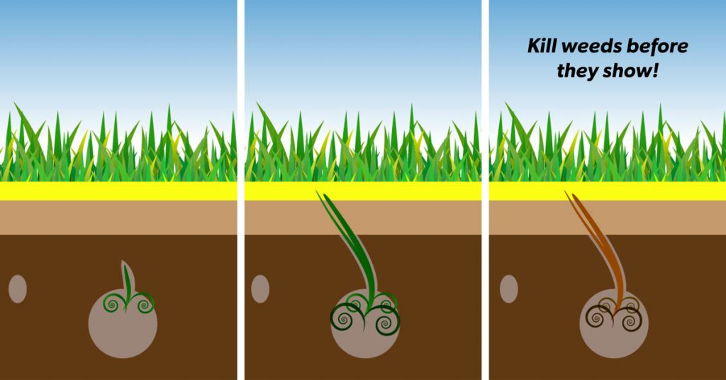
How to coordinate spring seeding with lawn care customers
The best practice for a homeowner that is currently using a lawn program, would be to aerate and seed in the fall, although many do choose to have the service in the spring.
It’s likely that our lawn care customers are highly concerned with weed and crabgrass control, unless they are on the organic program. Aerating and seeding in the spring will greatly reduce weed and crabgrass control by restricting our window to apply the right products at the right time.
All crabgrass pre-emergent barriers are applied in the spring before crabgrass germination. Keep in mind that Pre-m does not stop crabgrass from germinating, but it does stop it before it emerges from the soil. The pre-m will do the same to newly germinated grass seed, therefore cannot be applied if the lawn is being seeded.
Once the new seed has germinated and been mowed twice, we can resume weed control, but it will be harder to control crabgrass by this time.
One widely repeated statement about aeration in the spring is that it will destroy the crabgrass barrier rendering the pre-emergent treatment useless. While it’s hard to believe that this is a myth, there are many university studies proving it to be the case. I’ve inserted two statements below. The first from a university study the second from the pre-m label
“While most herbicide labels do not recommend aeration after preemergence herbicide application, university-conducted research has not shown an adverse effect on crabgrass control.
Disturbing the herbicide barrier with cultural practices such as disking may result in reduced weed control. (disking a lawn is similar to plowing).
When we complete an aeration and overseeding in the spring we should make sure to update the lawn account to reflect the date completed and to alert our lawn specialist of the new seed.

